Slide 1
Types of ML Algorithms
Types of learning

Slide 2
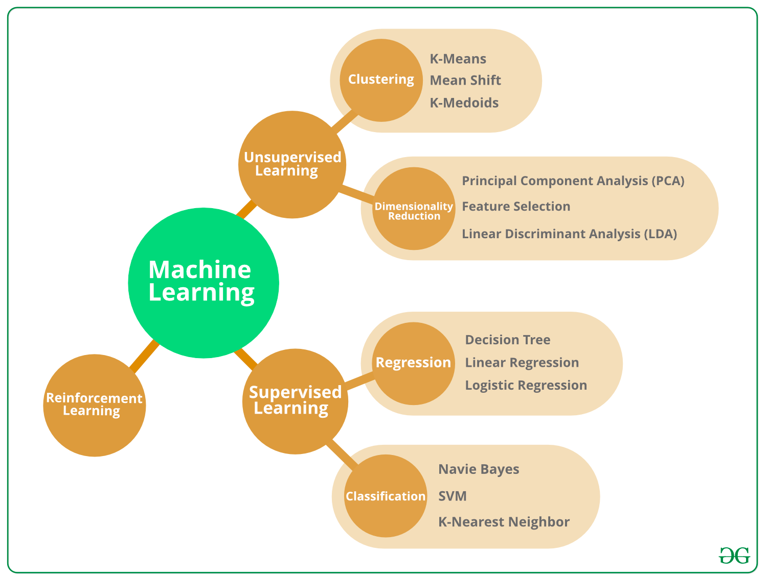

Slide 3
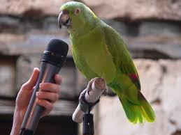
Supervised Learning
Labeled examples
Human Guiding the Algorithms
Classification, Regression

Slide 4
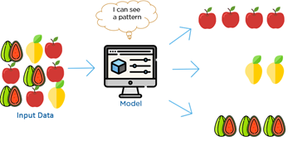
Unsupervised Learning
Unlabeled examples
No Human Intervention
Clustering, Dimensionality Reduction

Slide 5
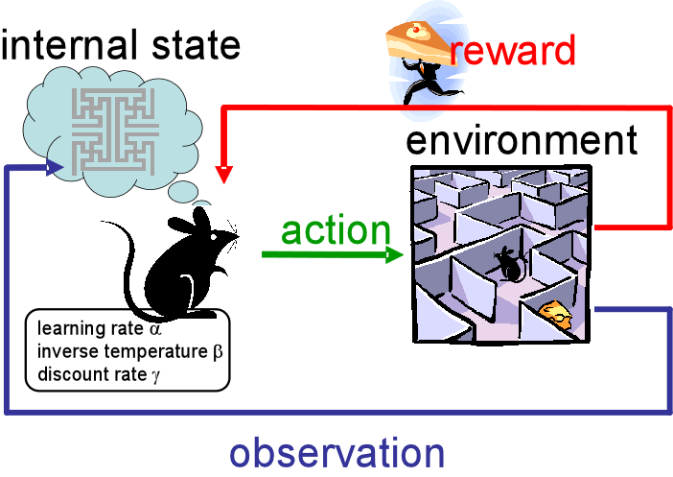
Reinforcement Learning
No examples, No Human Intervention
Learn by trial and error
Robotics, Games, Industry Automation

Slide 6
Types of Learning
Supervised: Learn from labeled examples
Unsupervised: Learn from unlabeled examples
Reinforcement: Learn by trial and error

