Slide 1
Week 1

Slide 2
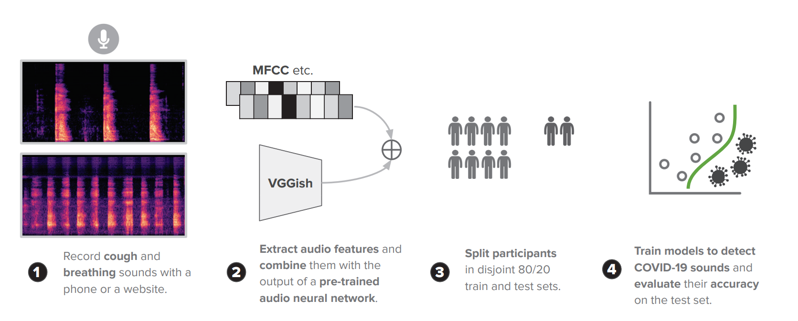
KDD paper-workflow
Handcrafted features
Feature extractor tool: transform the raw audio waveforms into features
“simple” ML models, no deep learning
Cambridge UK dataset

Slide 3
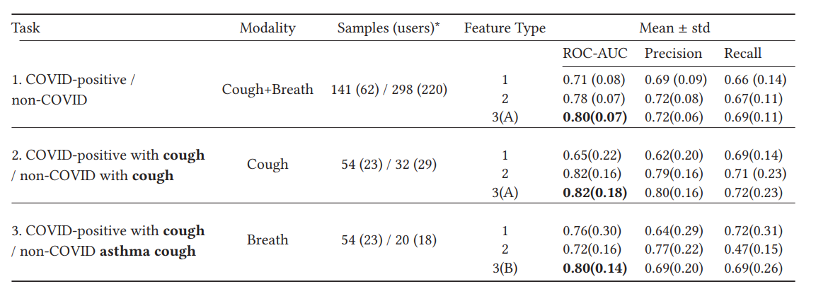

KDD paper-results
Feature Types
1 handcrafted only
2 VGGish only
3 handcrafted + VGGish
Reproduce results

Slide 4
Interspeech Challenge 2021
Sub-challenge 1: COVID-19 Cough Sub-Challenge (CCS)
Sub-challenge 2: COVID-19 Speech Sub-Challenge (CSS)
Sub-challenge 3: The Escalation Sub-Challenge (ESS)
Sub-challenge 4: The Primates Sub-Challenge (PRS)
binary classify COVID-19 (or not) infection

Slide 5
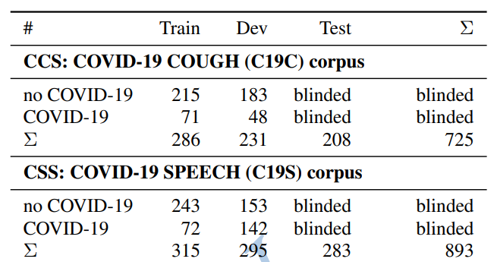
Interspeech Challenge-data
Subsets from same Cambridge UK dataset
Sub-challenge 1: COVID-19 Cough Sub-Challenge (CCS)
725 recordings
Sub-challenge 2: COVID-19 Speech Sub-Challenge (CSS)
“I hope my data can help to manage the virus pandemic.”
893 recordings

Slide 6
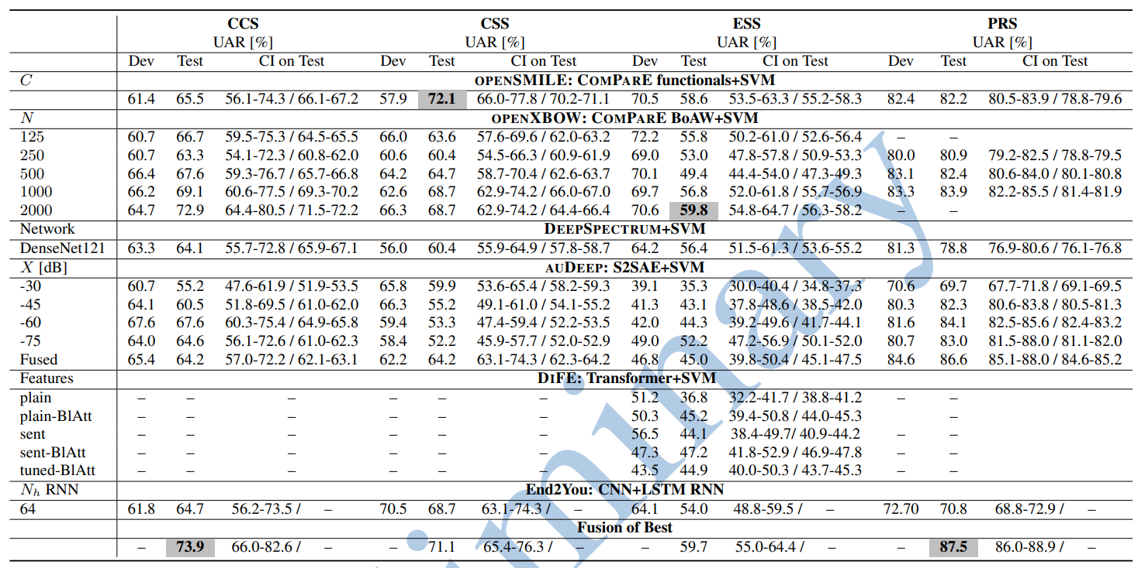

Reproduce results

Slide 7
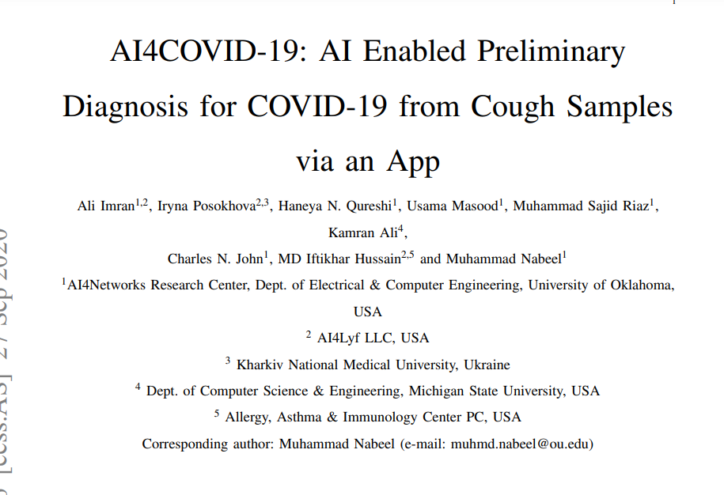
Options internship
KDD paper
Look into deep learning models, but other paper
Sub-challenge 1: COVID-19 Cough Sub-Challenge (CCS)
Similar to KDD paper
Sub-challenge 2: COVID-19 Speech Sub-Challenge (CSS)
Most interesting
Week 1: literature study KDD + Interspeech papers
Week 2: set up basic css (baseline is for linux only)
Week 3: more advanced css
Week 4: compare with conference papers
Week 5: make adjustments based on conference papers
Week 6: final results + prepare report and presentation

Slide 8
Questions
Sub-challenge 2: COVID-19 Speech Sub-Challenge (CSS)
Most interesting
Feedback?
Feature extraction ideas?
ML model ideas?
…
Week 1: literature study KDD + Interspeech papers
Week 2: set up basic css (baseline is for linux only)
Week 3: more advanced css
Week 4: compare with conference papers
Week 5: make adjustments based on conference papers
Week 6: final results + prepare report and presentation
openSMILE: COMPARE functional+SVM
openXBOW: COMPARE BoAW+SVM
deepSpectrum+SVM
end2You: CNN+LSTM RNN

Slide 9
Week 2

Slide 10
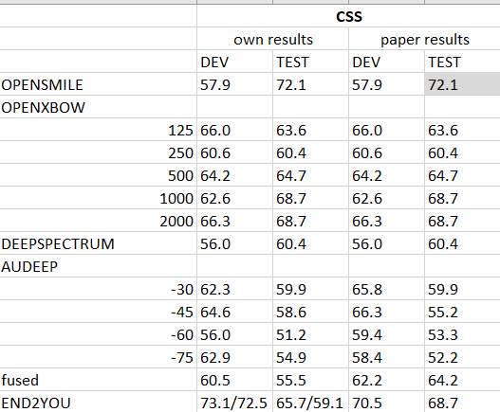
baseline

Slide 11
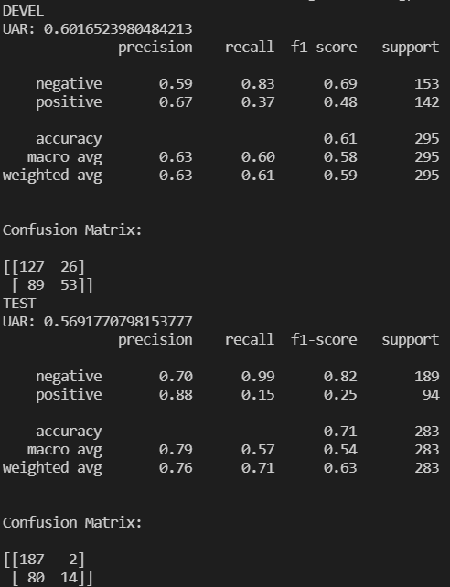
Handcrafted + svm

Slide 12
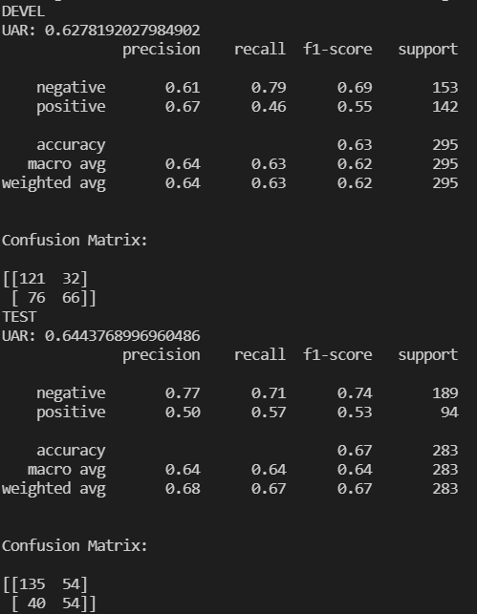
Vggsh + svm

Slide 13
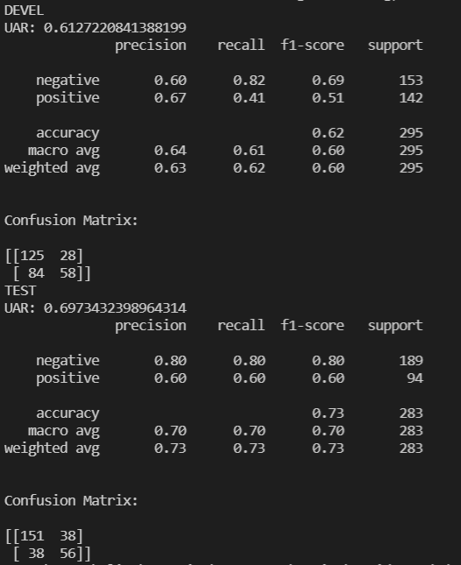

Handcrafted + vggsh + svm
SR → no effect
SR_VGG

Slide 14
Week 3

Slide 15
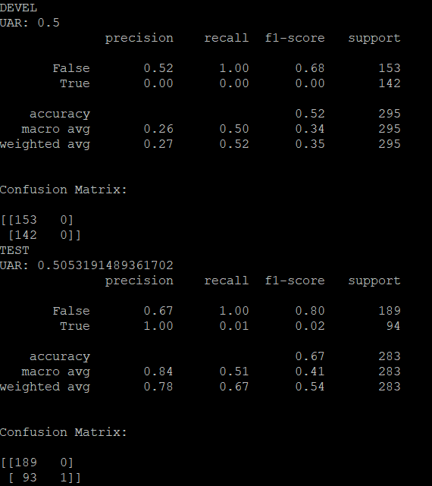
Handcrafted
+transformer

Slide 16
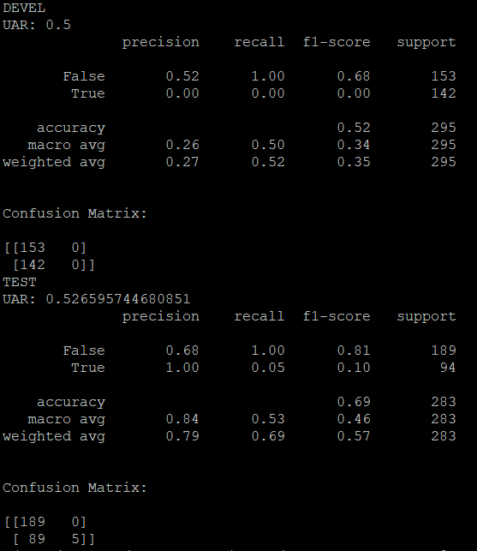
vggsh
+transformer

Slide 17
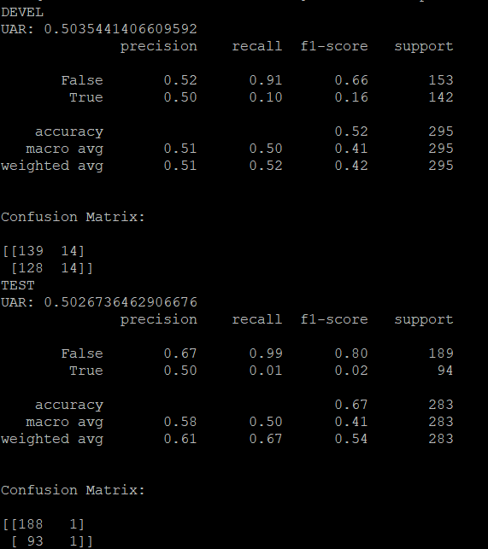
Handcrafted + vggsh
+transformer

Slide 18
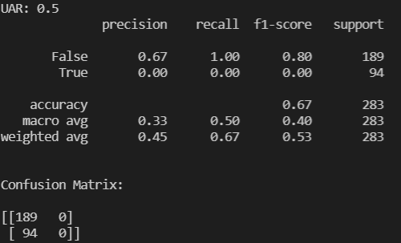
Lstm

Slide 19
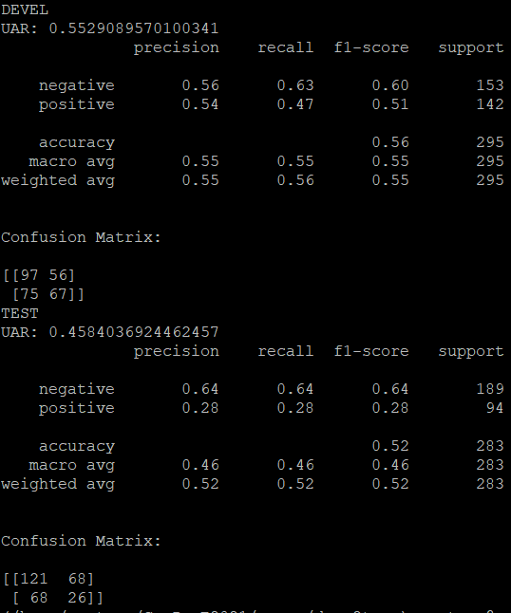
Openl3 + statistical function
+ svm

Slide 20
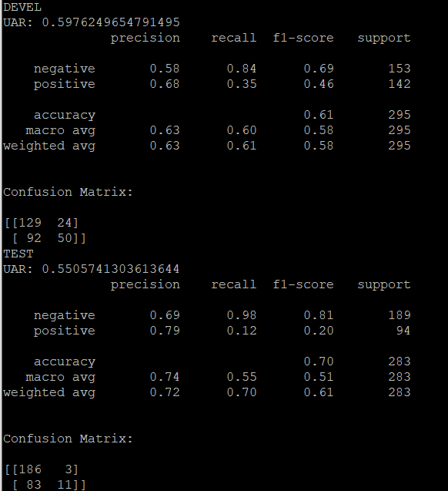
Hand
+Openl3 + statistical function
+svm

Slide 21
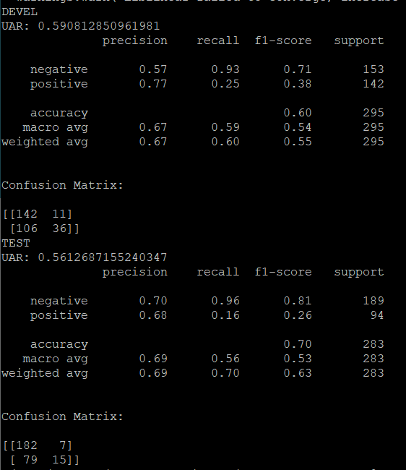
Hand
+ vgg
+ openl3 (+ stat function)
+svm

Slide 22
Week 4

Slide 23
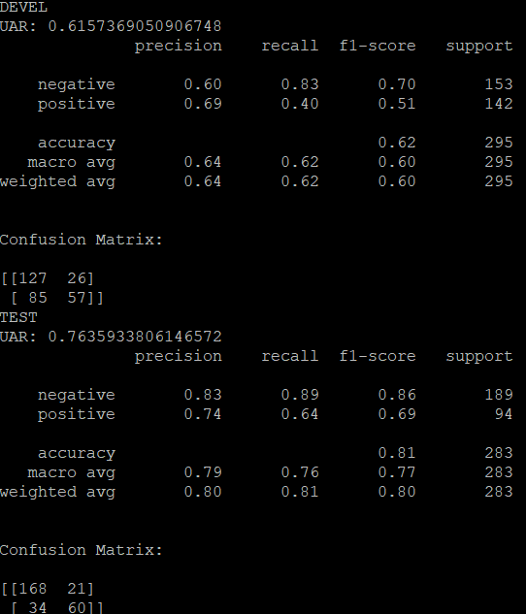
Found bug in vggsh (labelling)
Handcrafted + vggsh + svm

Slide 24
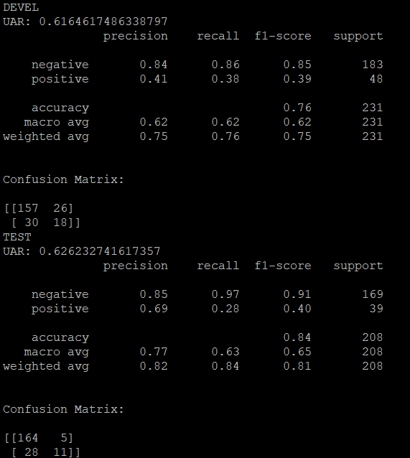
COUGH hand + svm

Slide 25
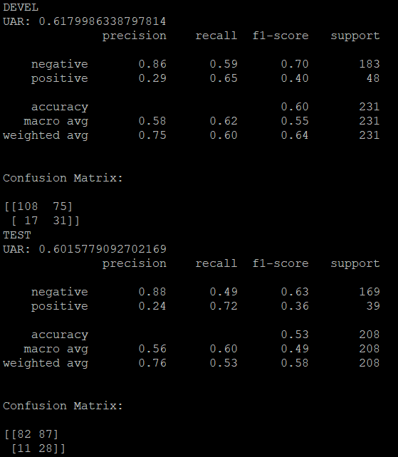
COUGH vggsh +svm

Slide 26
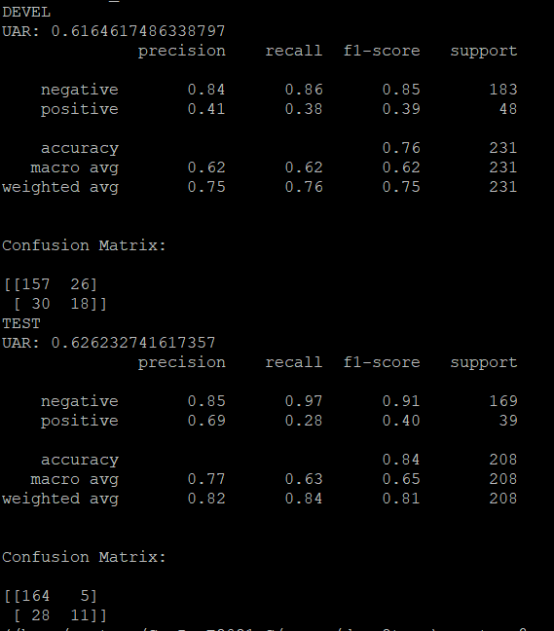
COUGH hand + vggsh+ svm

Slide 27
Week 5

Slide 28
Week 6

Slide 29
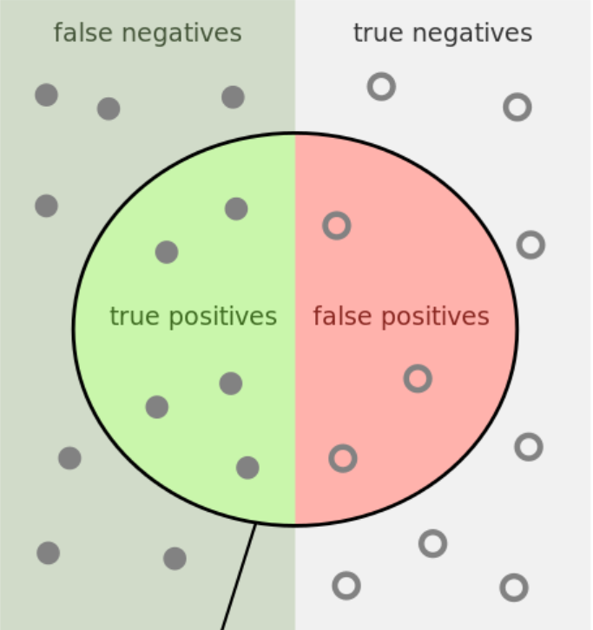
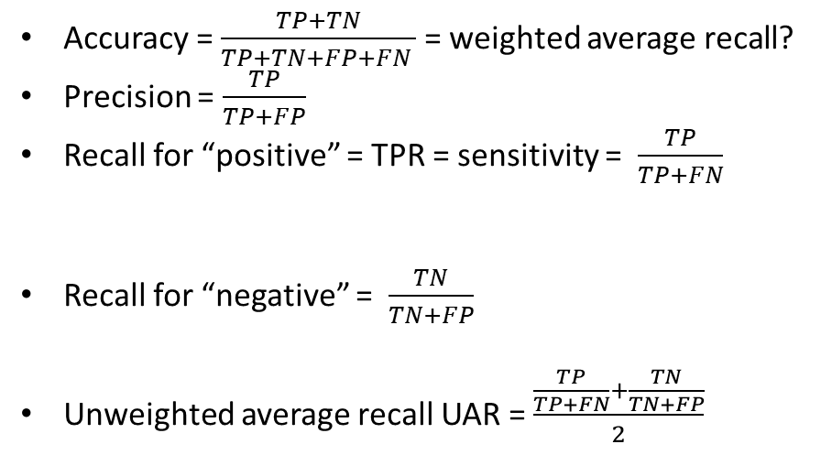
Overview metrics binary classification
Accuracy = $\frac{TP+TN}{TP+TN+FP+FN }$ = weighted average recall?
Precision = $\frac{TP}{TP+FP}$
Recall for “positive” = TPR = sensitivity = $\frac{TP}{TP+FN}$
Recall for “negative” = $\frac{TN}{TN+FP}$
Unweighted average recall UAR = $\frac{\frac{TP}{TP+FN}+\frac{TN}{TN+FP}}{2}$
UAR is defined as the unweighted average of the class-specific recalls achieved by the system, while for the WAR calculation the class-specific recalls are weighted by the prior probabilities of the respective classes

